Slide 1

Maze Game

Slide 2
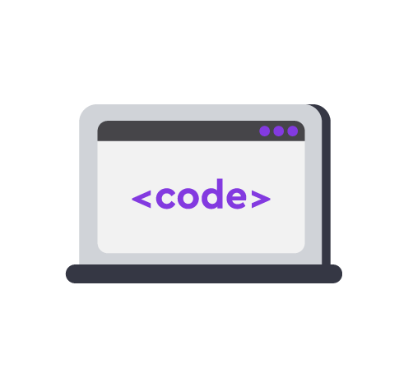

Project goal :
The game is about a player go through a maze with enemy,where the player must reach the end of the game without toutching the enemy to win.
Presentation
of the project

Slide 3
Particular features of the project
1-Game window
2-Background image
3-Musical effects
4-Treasure
5- Images for player and enemy
6-Walls
Presentation
of the project

Slide 4
Particular features of the project
(There are two types of characters in the game ...)
There are two characters:
1. Player.
2. Enemy
Presentation
of the project

Slide 5
Particular features of the project
(The game has demonstrative counters ...)
There are no counters in the game.
Presentation
of the project

Slide 6
Particular features of the project
(Extras: how to increase the game difficulty ...)
By adding more enemies to the maze.
By adding timer to the game so that the player must reach
the end of the maze before the time end.
Presentation
of the project

Slide 7
Project prospects
(Will the game make profit? Any possible improvements?)
By adding more enemies .
By adding timer to the game, where the player must reach the end of the game before the time end.
Presentation
of the project

Slide 8
The developed project includes the following components:
GitHub repo:
https://github.com/adamkaireem/shooter-game-.git
Presentation
of the project

Slide 9
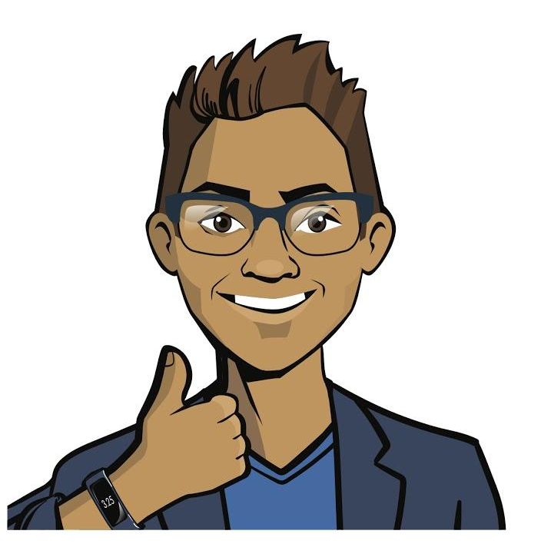
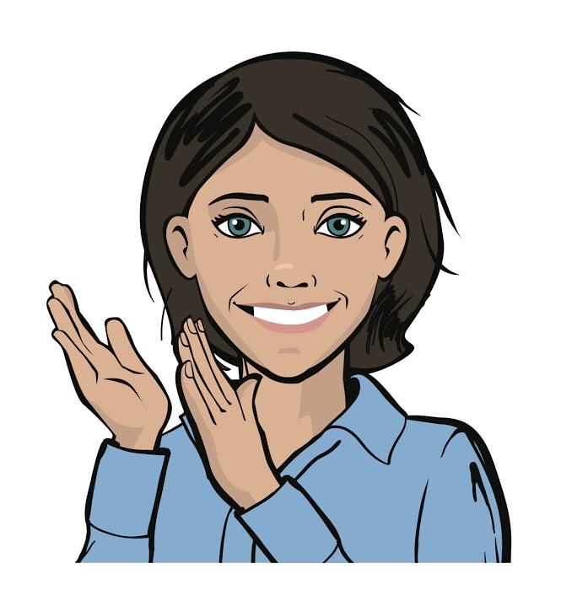
Thank you for your attention
We will be glad to answer your questions and receive feedback.
Thank you for your attention
Presentation
of the project

Slide 10
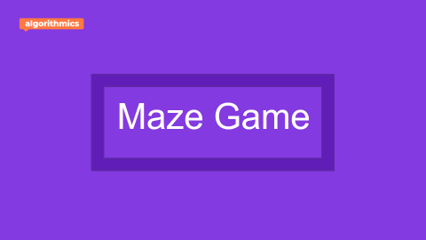
Adam kareem
Maze Game

